Slide 1
Active Learning with Deep Gaussian Processes for Aero Database Construction
AISC, UNC Greensboro
October 13, 2024
Shih-Ni Prim
North Carolina State University

Slide 2
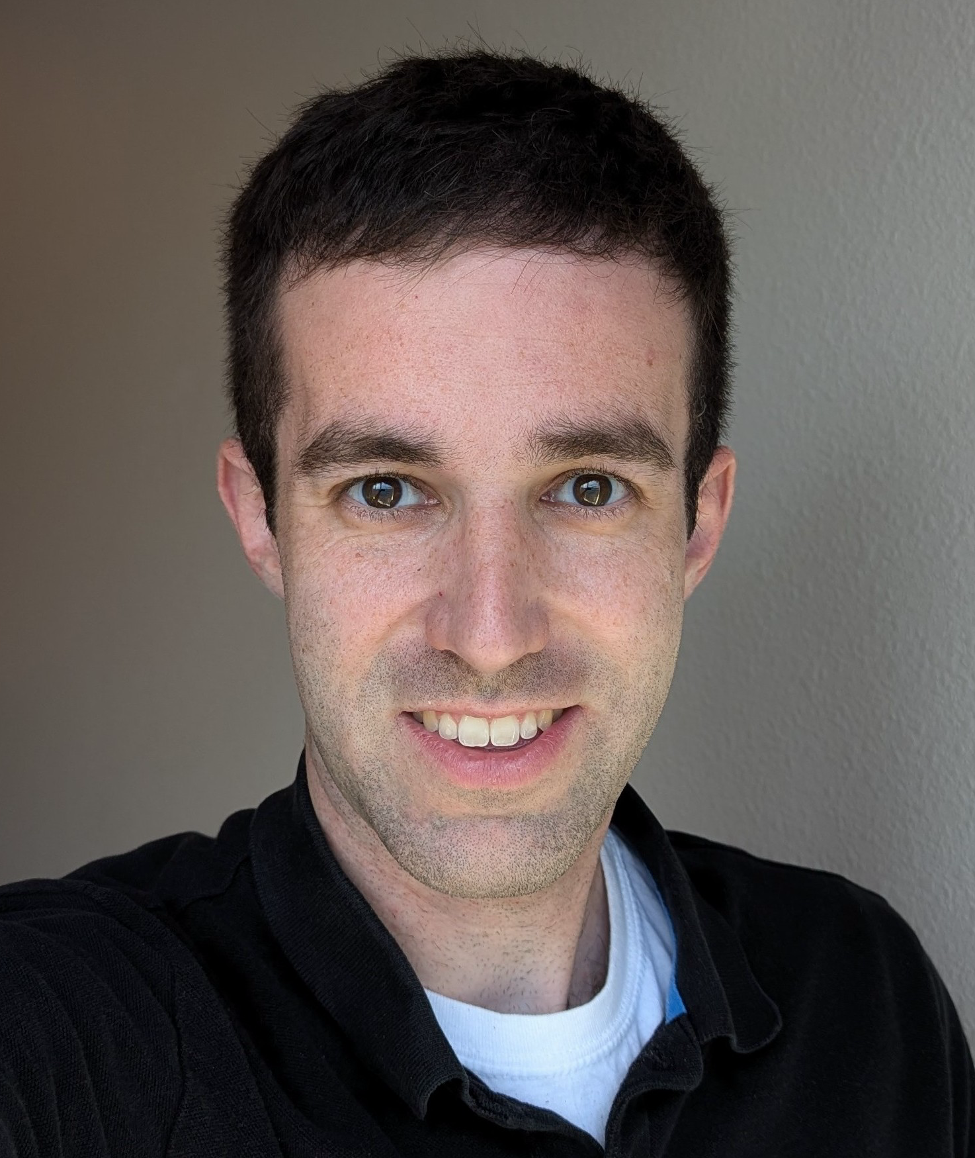
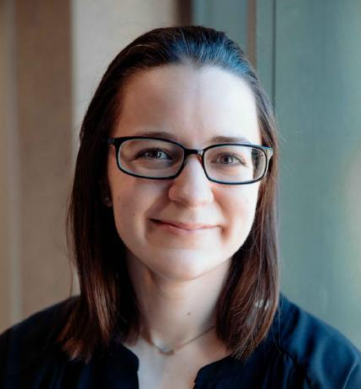

Special thanks to collaborators and summer internship
This work originated from my summer internship at Data Science Summer Institute of Lawrence Livermore National Laboratory
Kevin Quinlan, Lawrence Livermore National Laboratory
Annie Booth, North Carolina State University
Jagadeesh Movva, Lawrence Livermore National Laboratory

Slide 3
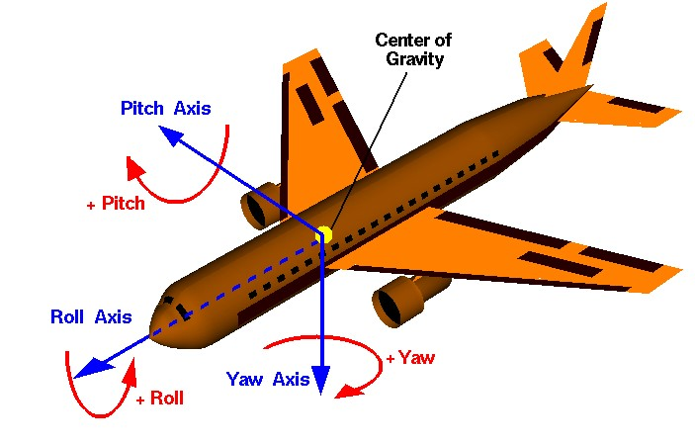
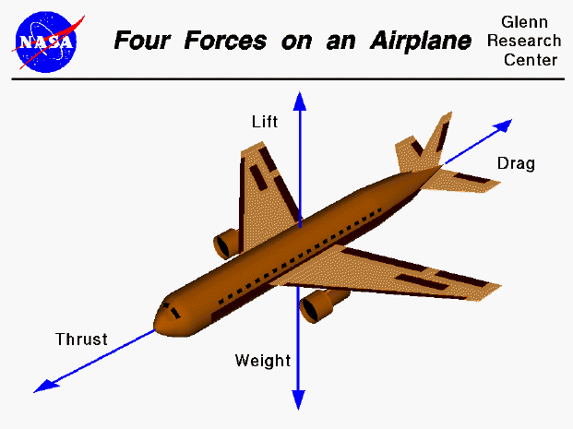
Generation of Aerodynamic Databases
A well converged aero-database is essential for accurate simulation of flight dynamics
The forces and moments depend on speed, angle, deflections, etc.
Generation of high-fidelity aerodynamic data is computationally expensive
  More challenging for the larger parameter space for non-ballistic problems
We use a surrogate model to represent this aero-database

Slide 4
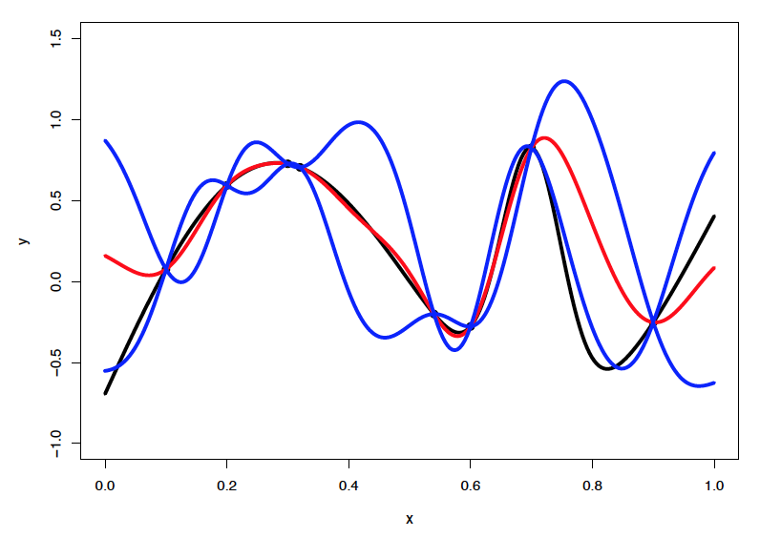
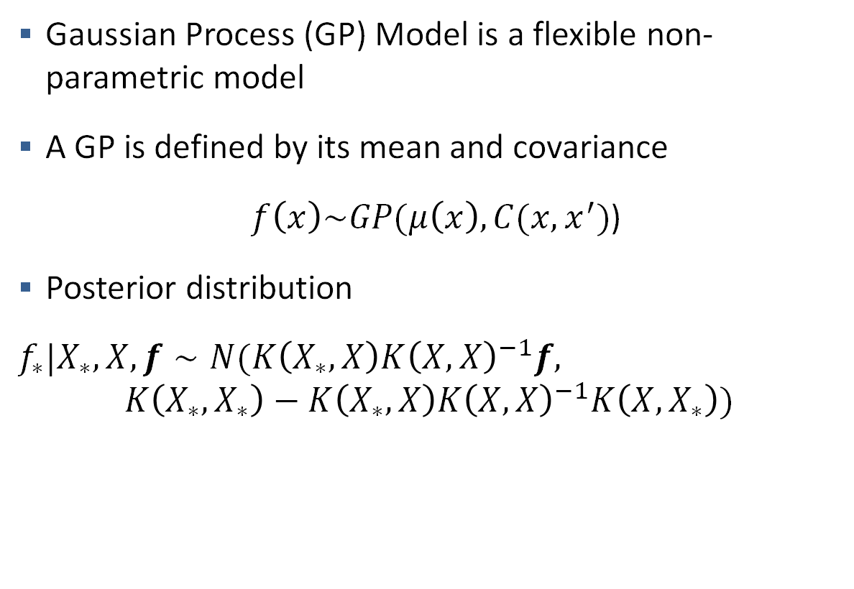
Surrogate Model for Computer Experiment: Gaussian Process
Gaussian Process (GP) Model is a flexible non-parametric model
A GP is defined by its mean and covariance
$f\left(x\right)\sim GP(μ\left(x\right), C(x,x^{′})$)
Posterior distribution
$f_{∗}|X_{∗}, X, f∼N(K\left(X_{∗},X\right)K{\left(X,X\right)}^{−1}f,$
$$K\left(X_{∗},X_{∗}\right)−K\left(X_{∗},X\right)K{\left(X,X\right)}^{−1}K\left(X,X_{∗}\right))$$

Slide 5
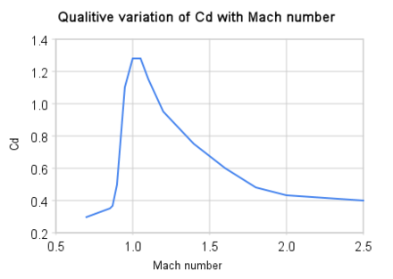
Beyond Simple Gaussian Process Models
GPs assume the surface is stationary
However, stationarity is not guaranteed
  Rapid changes of drag around mach 1 is an example
  (not included in our data)
Other versions of GP for non-stationary data:
  la GP: allow lengthscale parameter to vary locally
  Treed GP, Deep GP, etc.

Slide 6
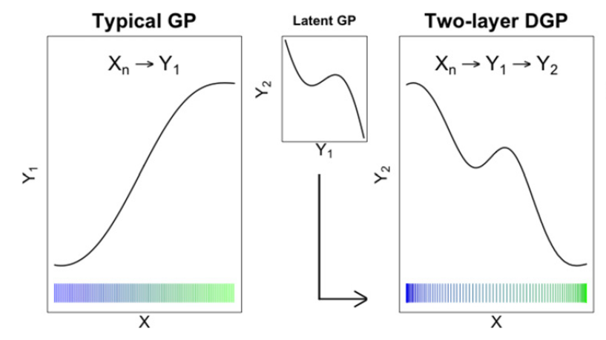
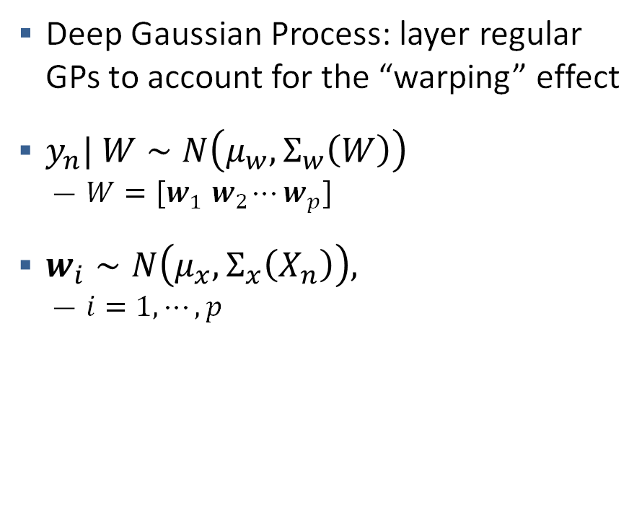
Deep Gaussian Process
Deep Gaussian Process: layer regular GPs to account for the “warping” effect
$y_{n}| W∼N\left(μ_{w}, Σ_{w}\left(W\right)\right)$
  $W=[w_{1}{ w}_{2}⋯w_{p}]$
$w_{i}∼N\left(μ_{x}, Σ_{x}\left(X_{n}\right)\right),$
  $i=1, ⋯, p$
Source: Annie Sauer, Robert B. Gramacy & David Higdon (2023). Active Learning for Deep Gaussian Process Surrogates, Technometrics, 65:1, 4-18.

Slide 7
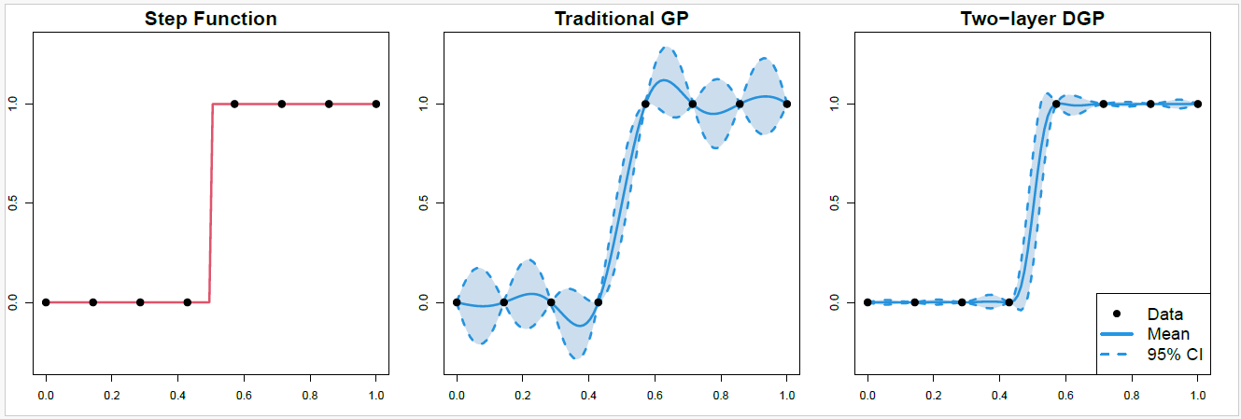
Deep Gaussian Process

Slide 8
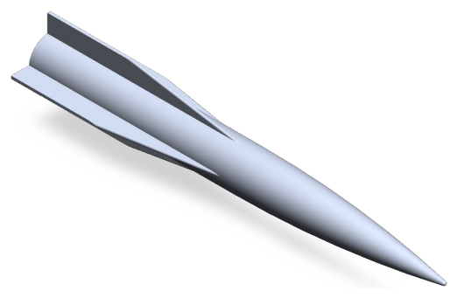
HARV Geometry Simulation Study
High-Speed Army Reference Vehicle
Generated by Computational Fluid Dynamics (CFD) simulations with solver CBAERO
HARV a cruciform geometry
  A re-entry body with four articulating fins
8 predictors: mach, alpha, beta, altitude, fin1, fin2, fin3, fin4
6 outcomes: 3 forces and 3 moments
~1600 points
Comparison of repeated draws of 300 samples

Slide 9
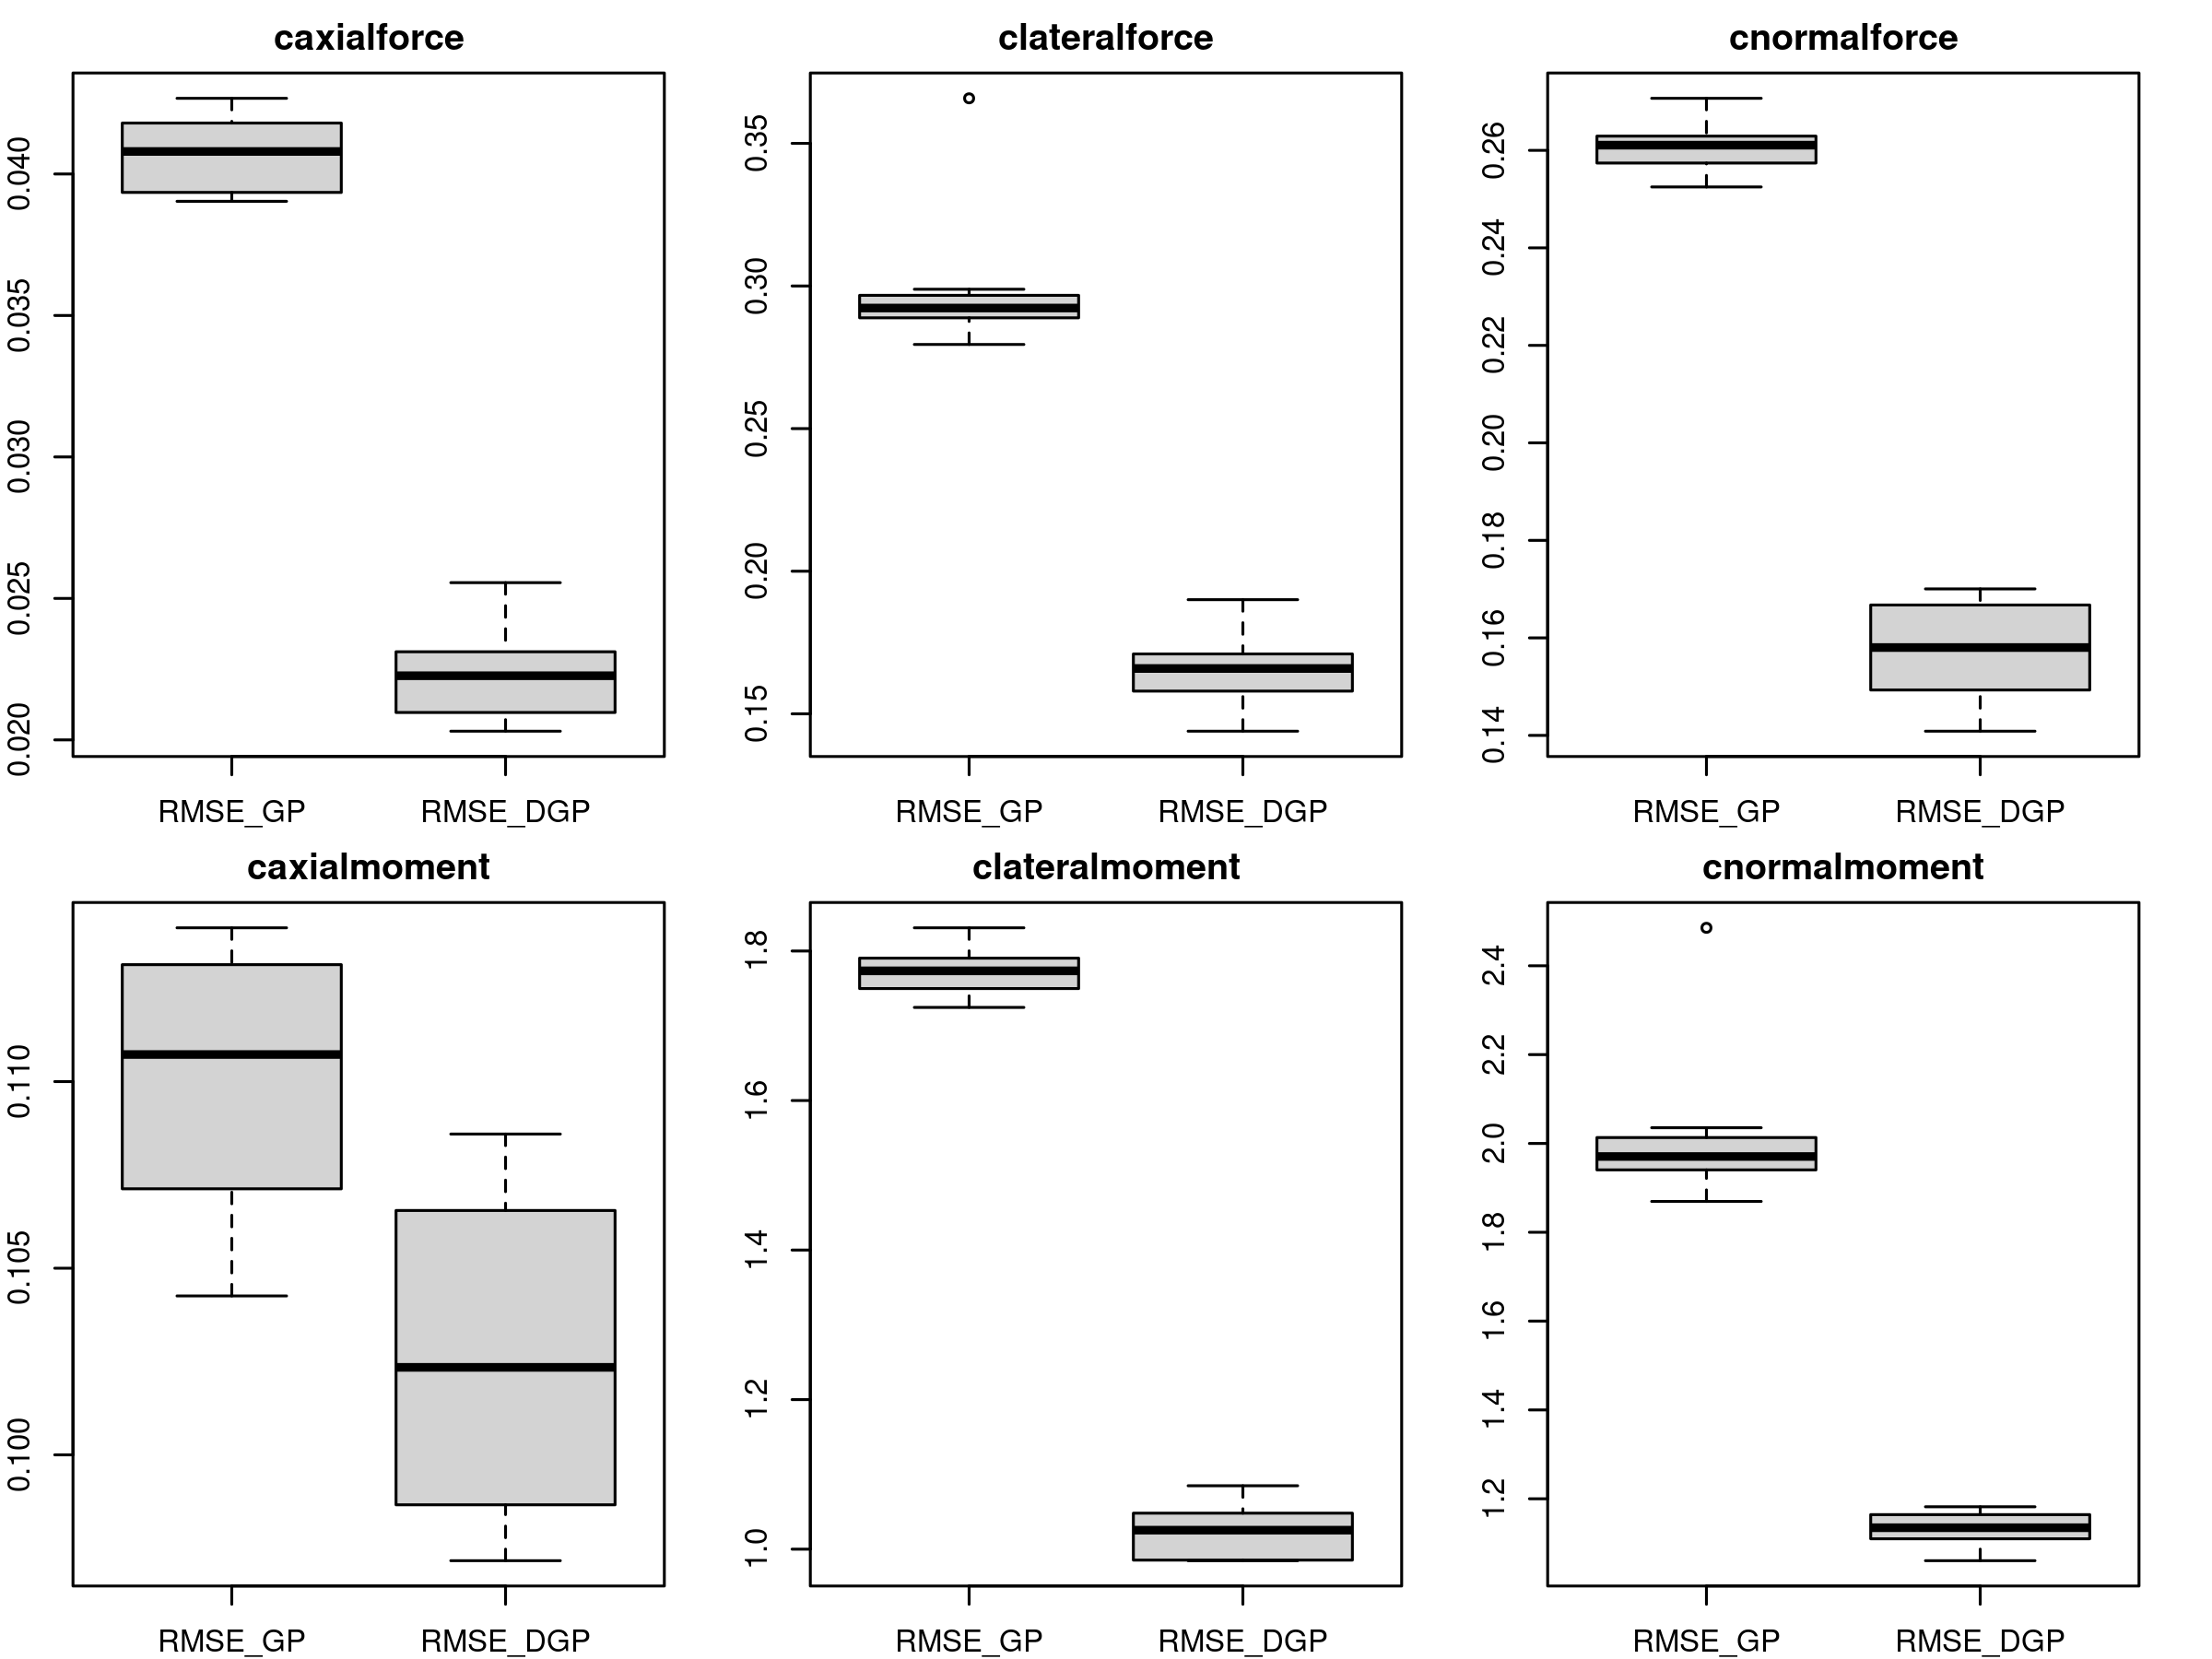
Root mean square error
Deep Gaussian Process Models Improve Significantly Over Standard GPs

Slide 10
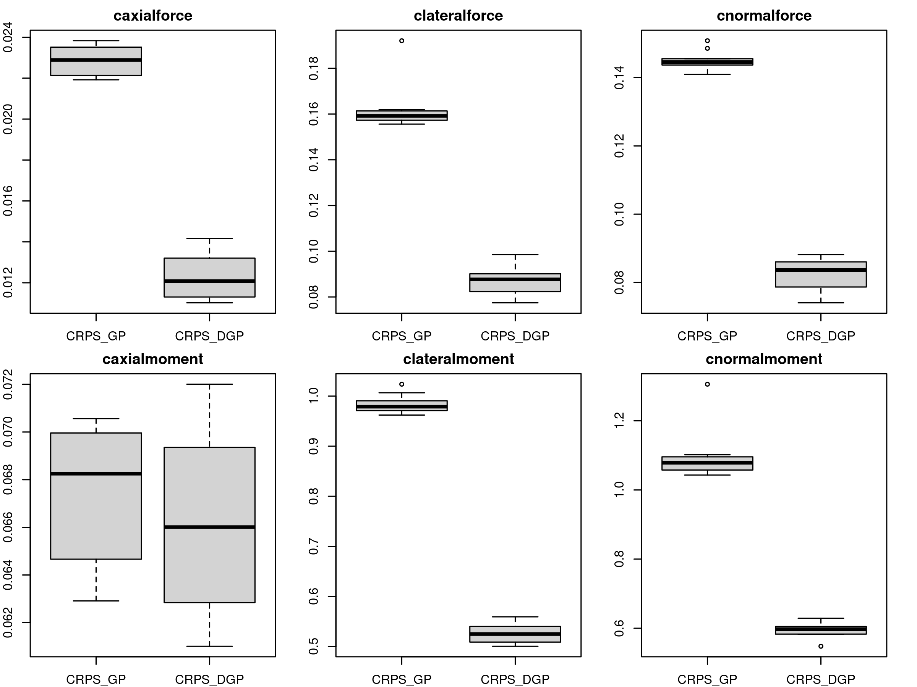
Continuous rank probability score
The result suggests that DGP might be useful for contour estimation and sequential design.

Slide 11
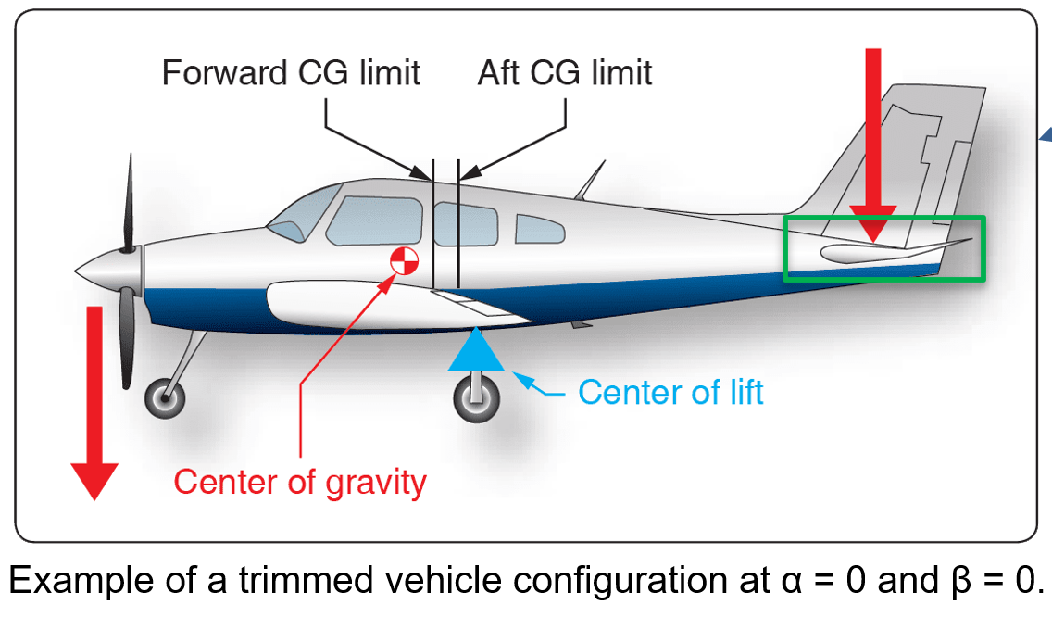
Trimmed Aero Database Construction
Not all points in the aero database are of interest
  Some flight conditions are not flown
  Some points are not stable flying conditions
Constraints make the search space smaller
  Better surrogates to find more efficient placement of samples
Trimmed condition: all moments equal zero

Slide 12
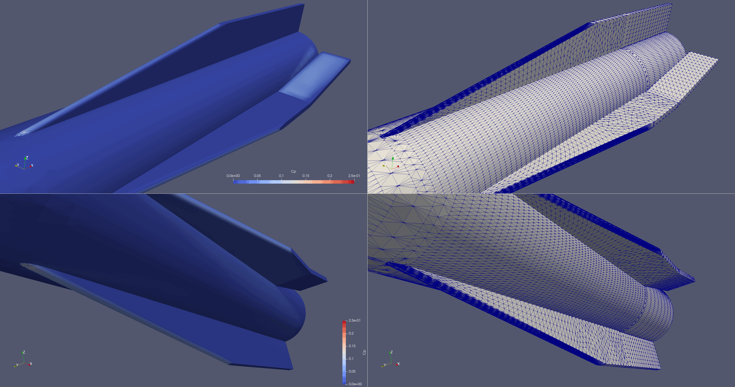
Trimmed Aero Database Construction
Degrees of Freedom:
  Mach, Alpha, Beta, Altitude (“environmental”)
  Fin 1, Fin 2, Fin 3, Fin 4 (“controllable”)
Three stages:
  Modeling: find points to build optimal models
  Inverse problem: With any given mach, alpha, beta, altitude, we want to find the values for 4 fins such that all 3 moments are zero.
  Optimization: minimize drag under the previous constraints.

Slide 13
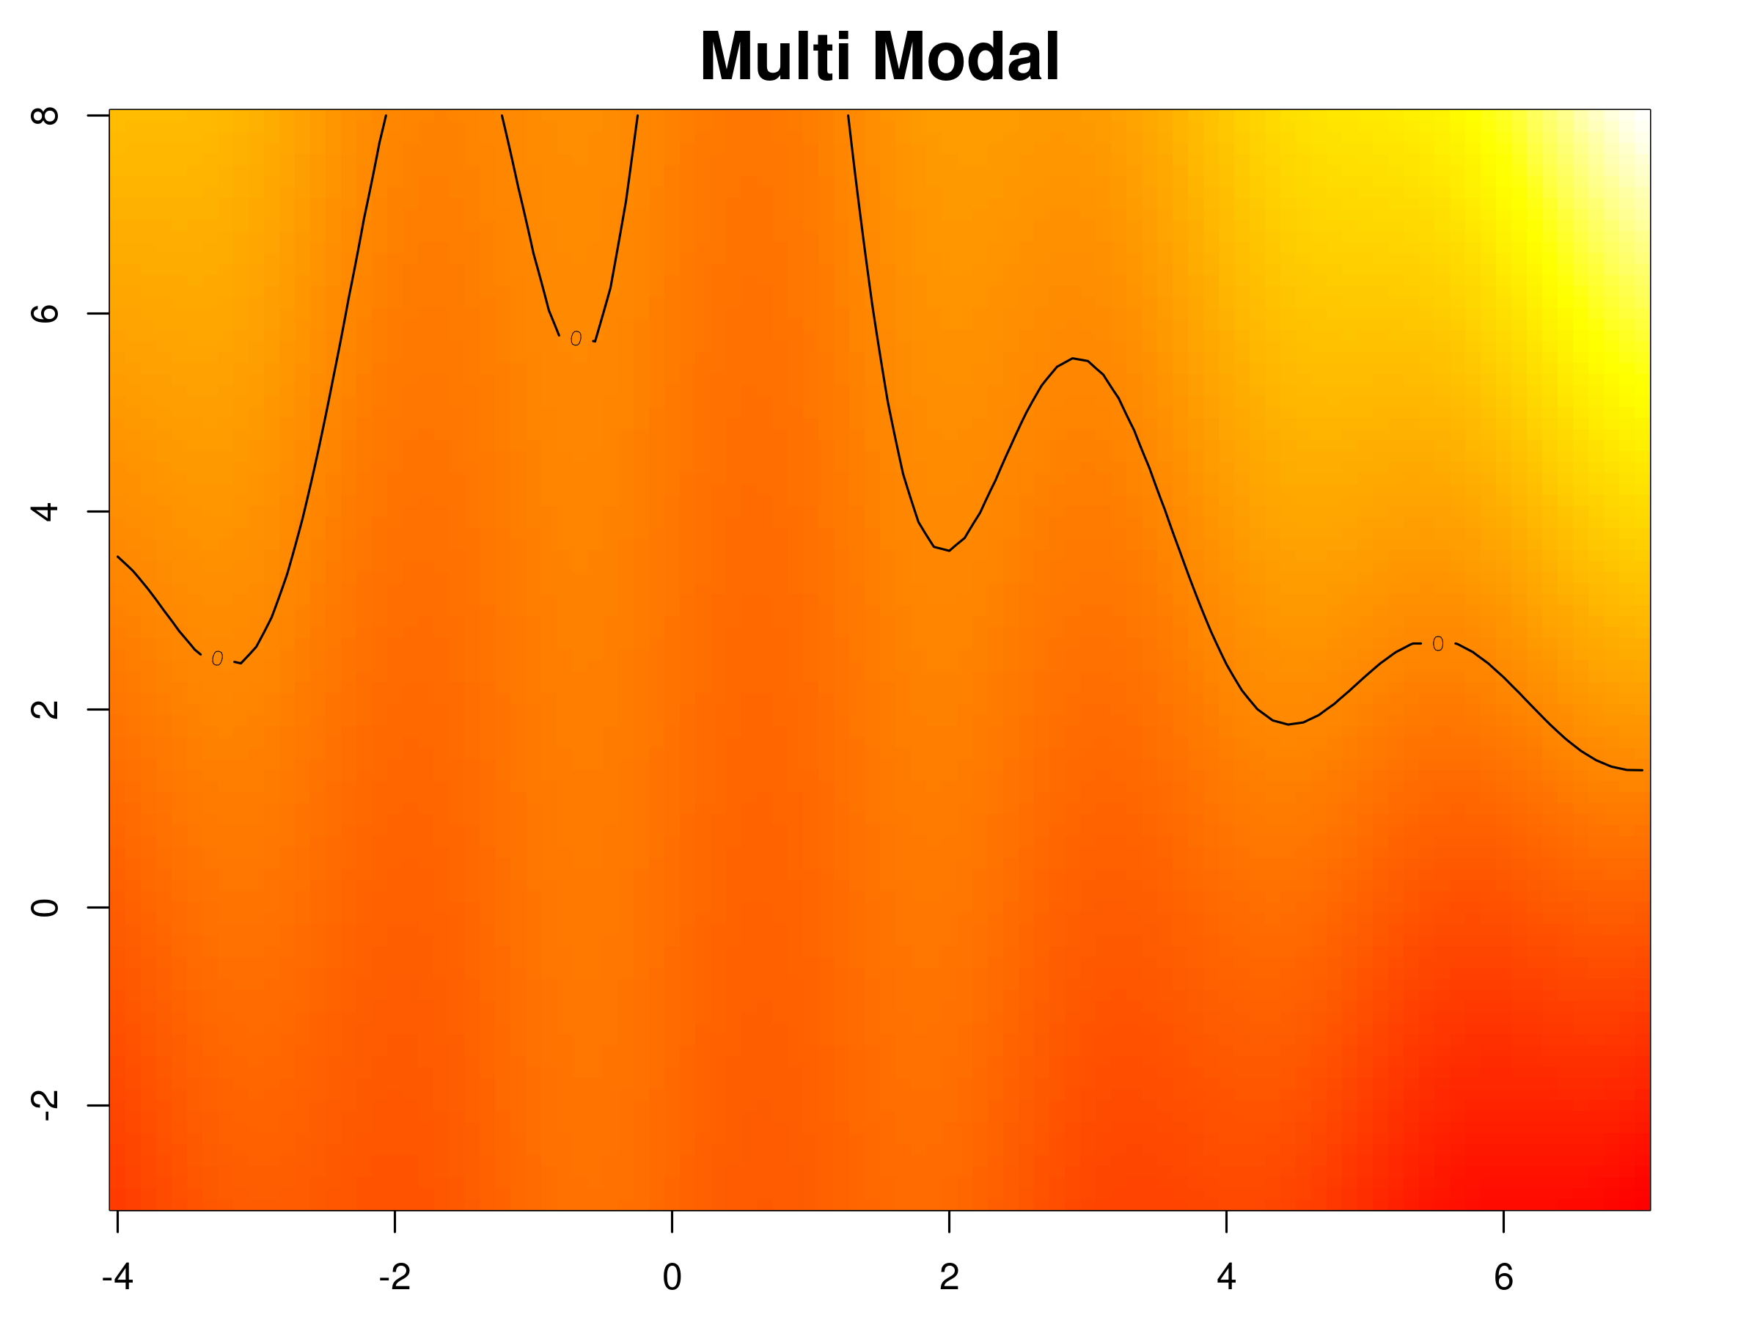
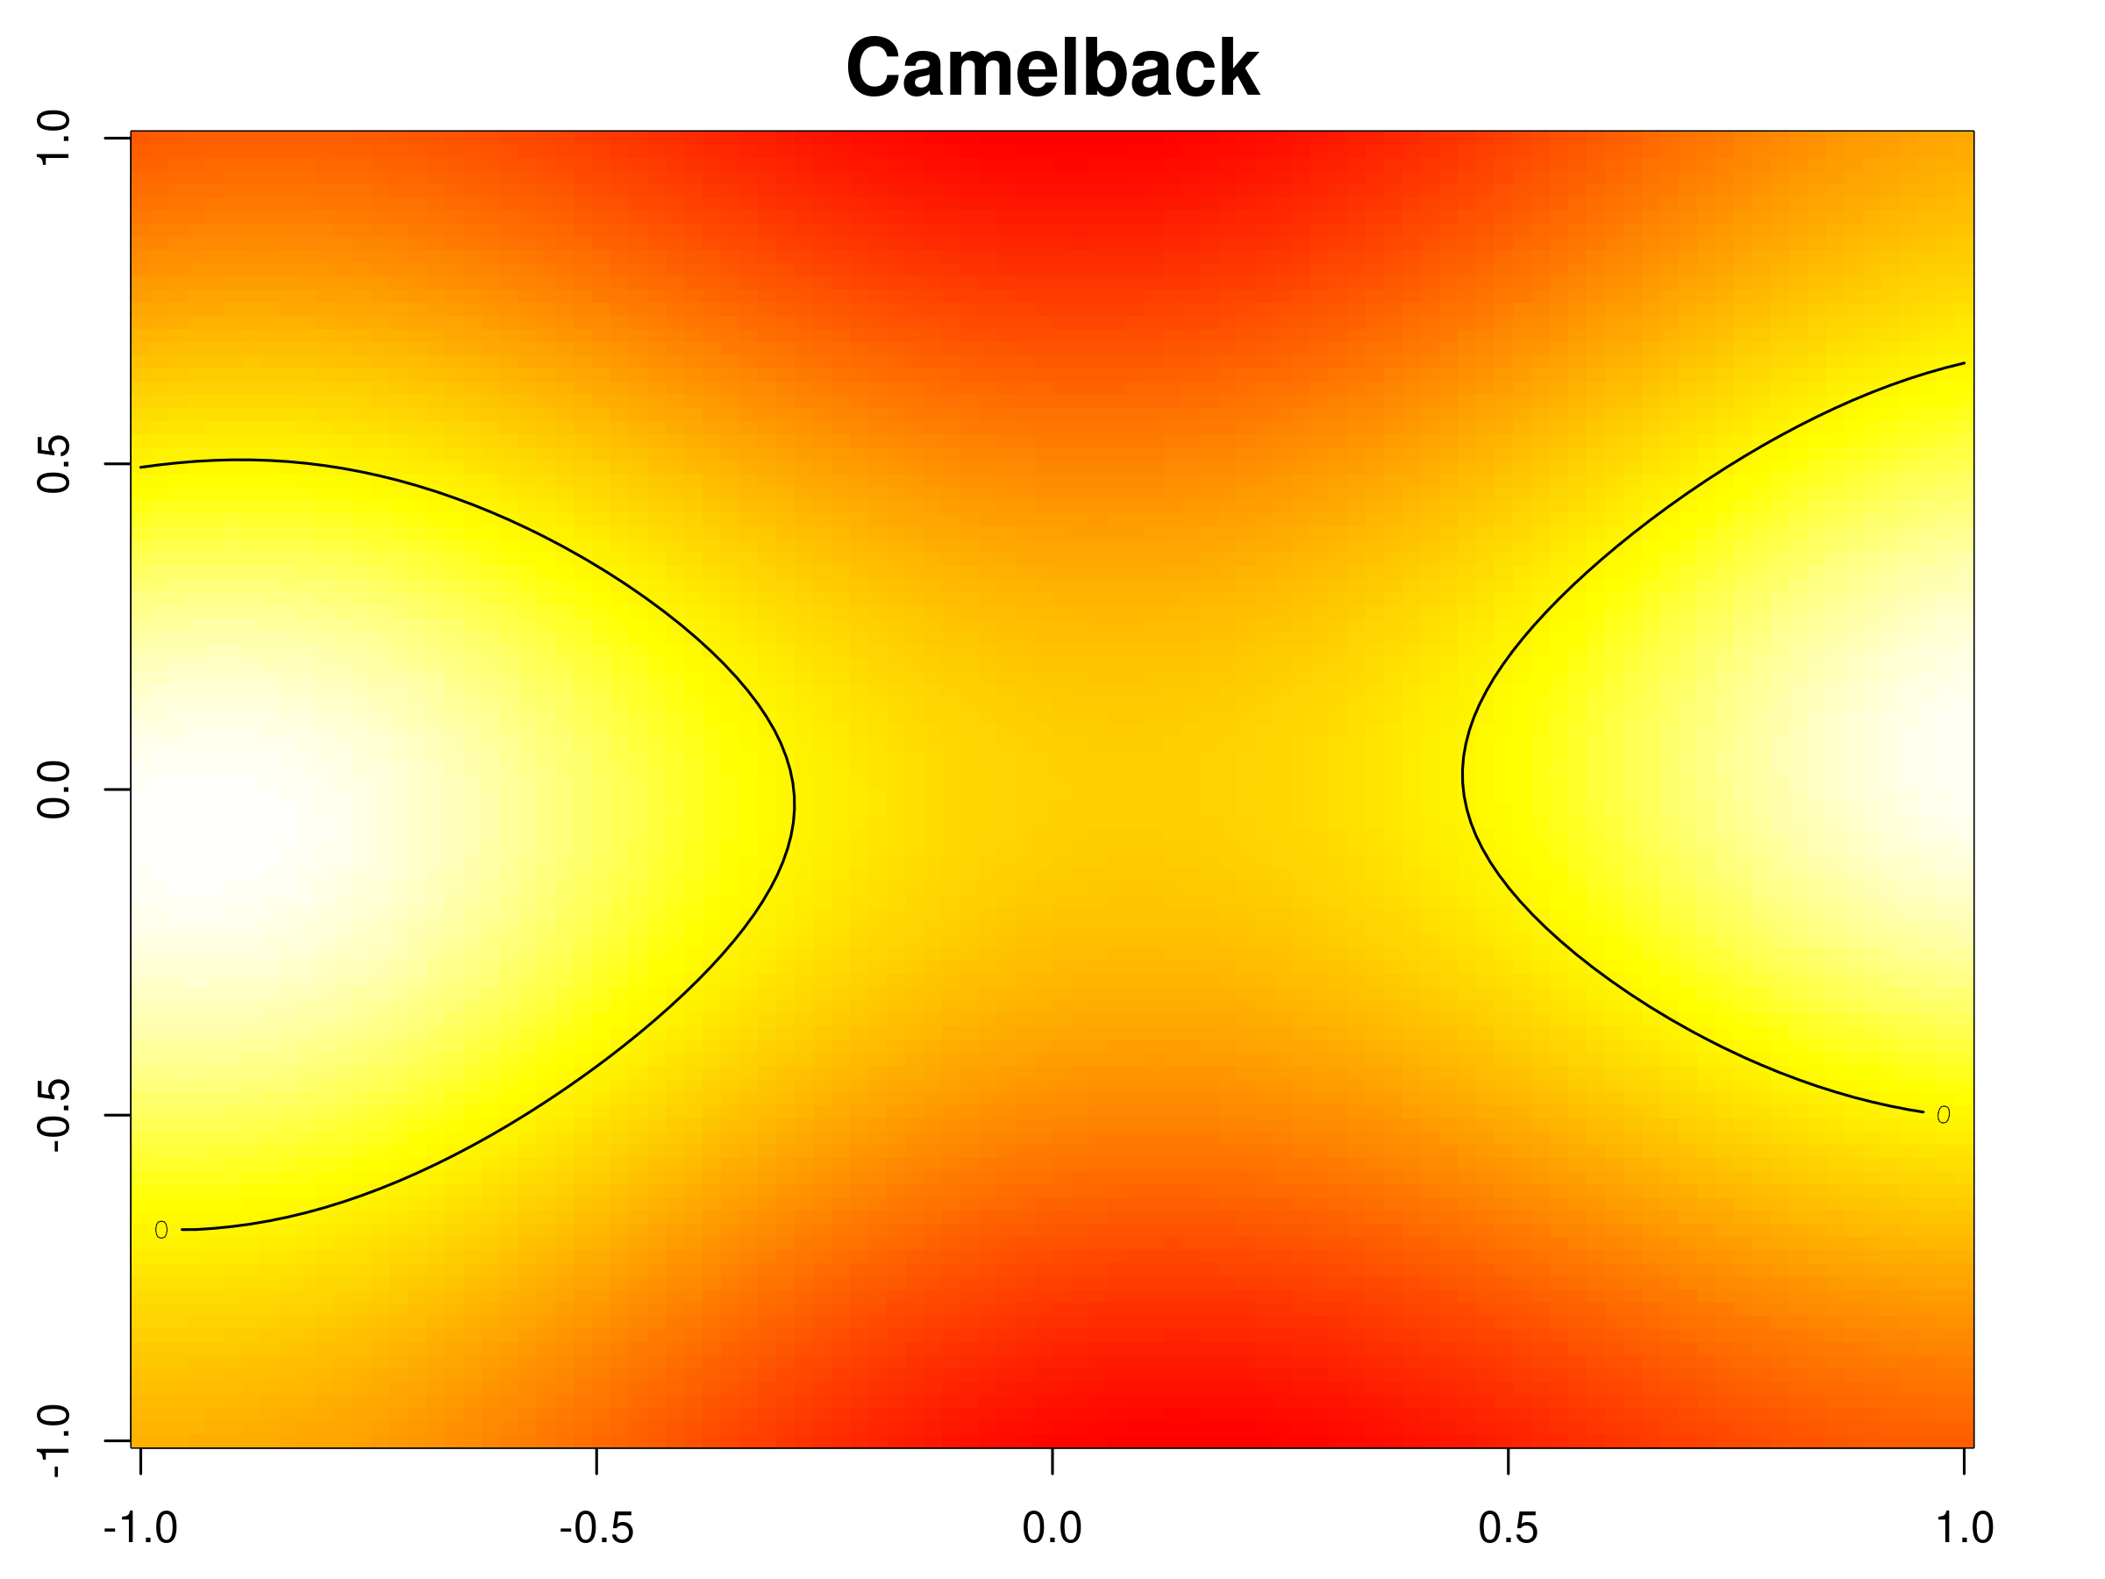
Use Contour Estimation to Construct Trimmed Aero Databases
Contour estimation commonly arises when finding failure regions (Cole et al, 2022)
Toy examples: multimodal and camelback functions
In our case, the contour is where the three moments equal zero.
Estimating three contours simultaneously is a challenge.
Rather than having all the points pre-selected, we use sequential designs
  Active learning
  use the current model to optimally chose the next point(s)

Slide 14
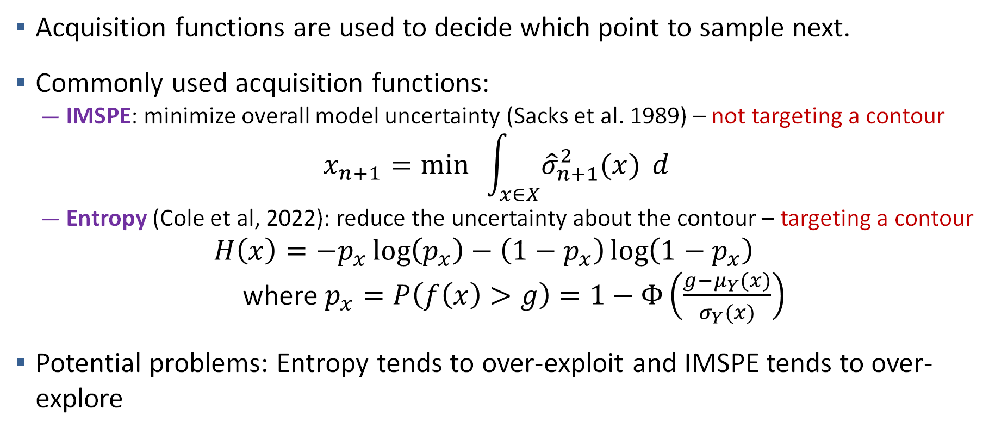
Active Learning + Contour Estimation
Acquisition functions are used to decide which point to sample next.
Commonly used acquisition functions:
  IMSPE: minimize overall model uncertainty (Sacks et al. 1989) – not targeting a contour
$$x_{n+1}=\min{ }\int_{x∈X}^{ }{{\hat{σ}}_{n+1}^{2}(x)} d$$
  Entropy (Cole et al, 2022): reduce the uncertainty about the contour – targeting a contour
  $$H\left(x\right)=−p_{x}\log\left(p_{x}\right)−\left(1−p_{x}\right)\log\left(1−p_{x}\right)$$
  where $p_{x}=P\left(f\left(x\right)>g\right)=1−Φ\left(\frac{g−μ_{Y}(x)}{σ_{Y}(x)}\right)$
Potential problems: Entropy tends to over-exploit and IMSPE tends to over-explore

Slide 15
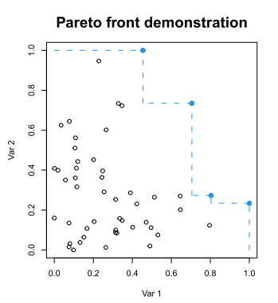
Active Learning + Contour Estimation
We want to strike a balance between exploration and exploitation.
One solution: Pareto front, which combines entropy and predictive variance. (Booth et al, 2024)
Source: Booth A. S., Renganathan S. A., and Gramacy R. B. (2024). “Contour Location for Reliability in Airfoil Simulation Experiments using Deep Gaussian Process.” arXiv: 2308.04420v2.

Slide 16
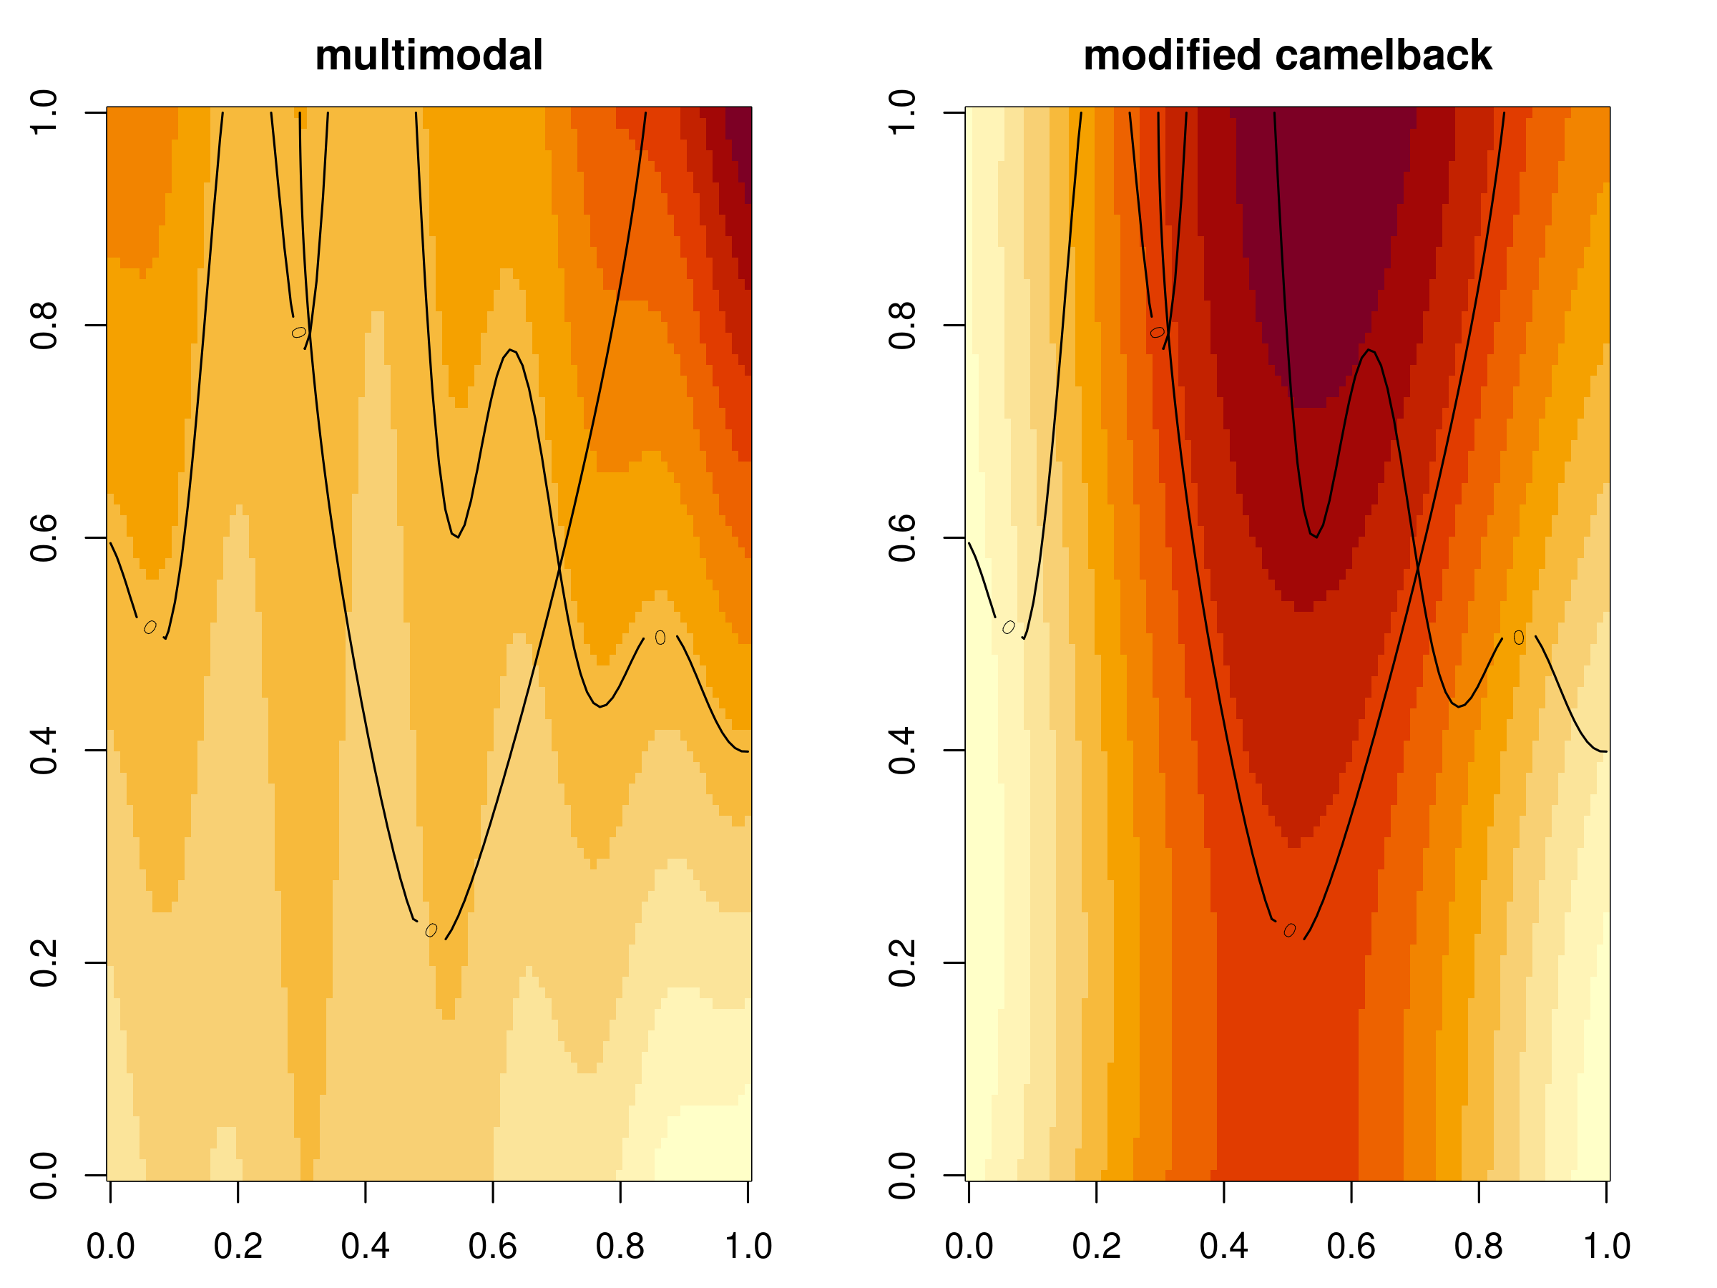
Challenge: working with multiple contours simultaneously
Initial simulations show that we need to fine-tune ways to combine acquisition functions for different contours.
To create a toy example that mimics the aerodynamic surface, we combine multimodal and modified camelback.
Our goal is to find the areas where the two curves intersect, where the values of both surfaces are zeros.

Slide 17
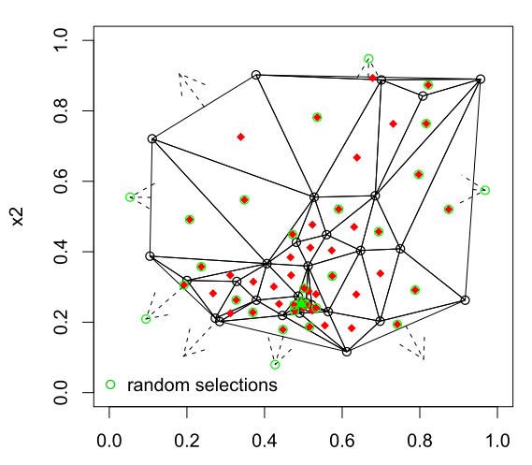
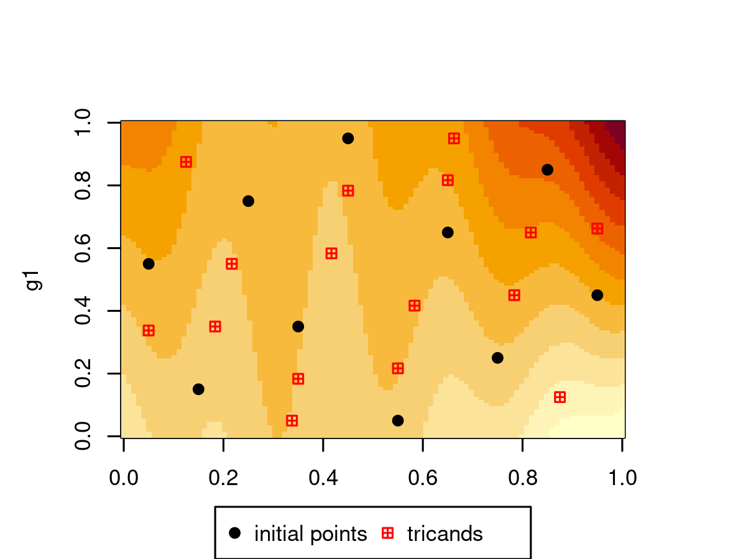
Proposed method: 3D pareto front + tricands
Use pareto front with 3 criteria (entropy sum, two individual predictive standard deviation)
Delaunay triangulation candidates (tricands)
  Interior and fringe candidates
  Targeted sub-sampling
  Useful for deep GP
Source: Gramacy, R. B., Sauer, A. and Wycoff, N. (2022) Triangulation candidates for Bayesian optimization. arXiv: 2112.07457.

Slide 18
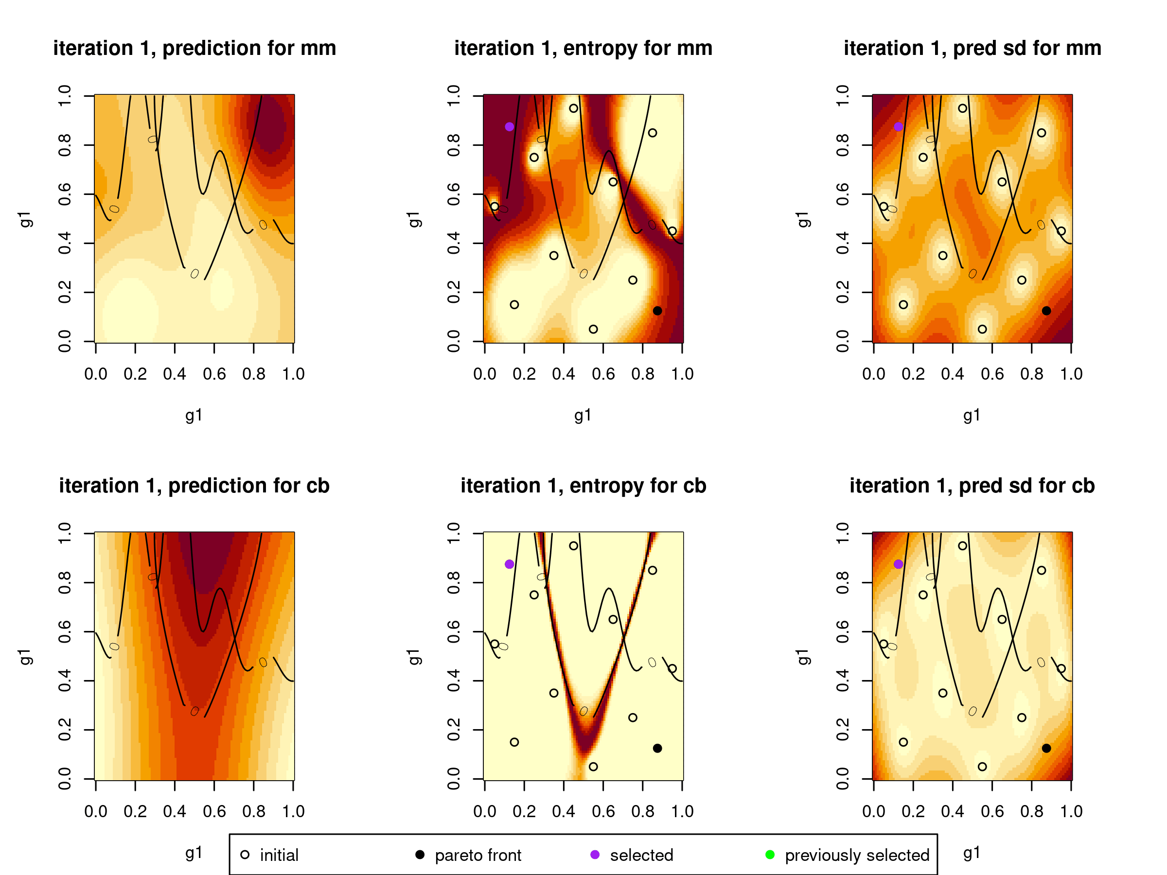
Demonstration of Proposed Method

Slide 19
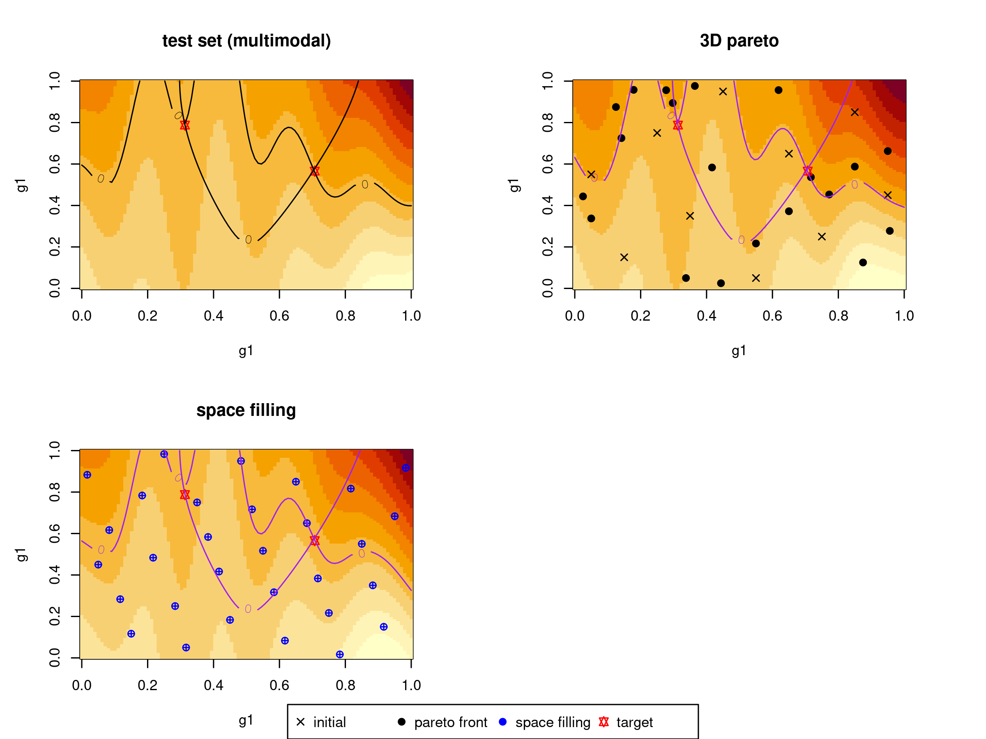
Comparison
Pareto front: 10 initial points, 20 selected points
  Targets contours and uncertain areas
Space filling: 30 points
  Spread out in space

Slide 20
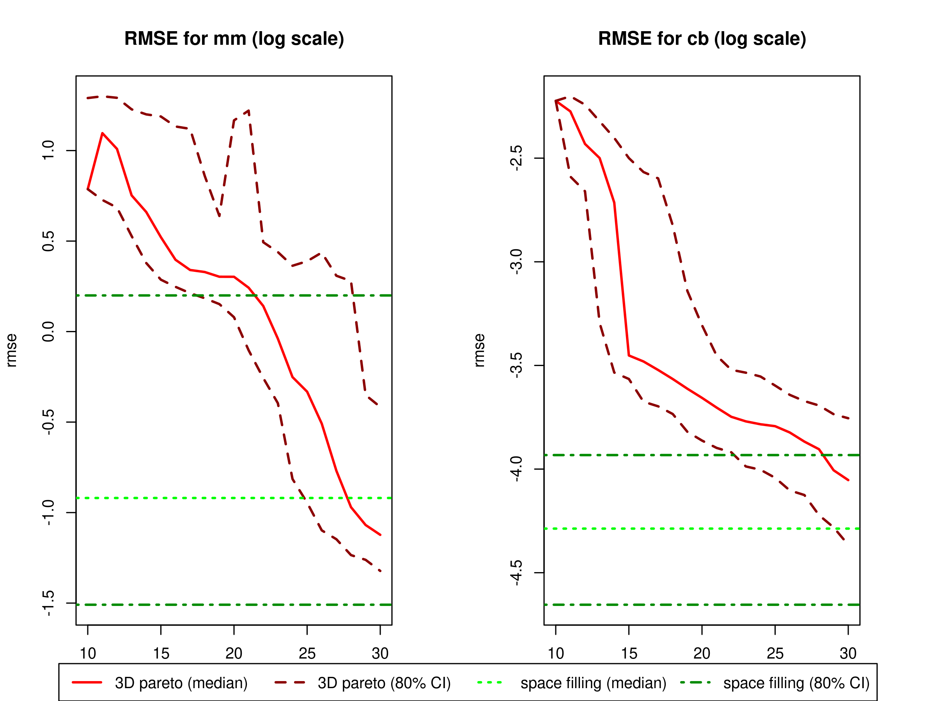
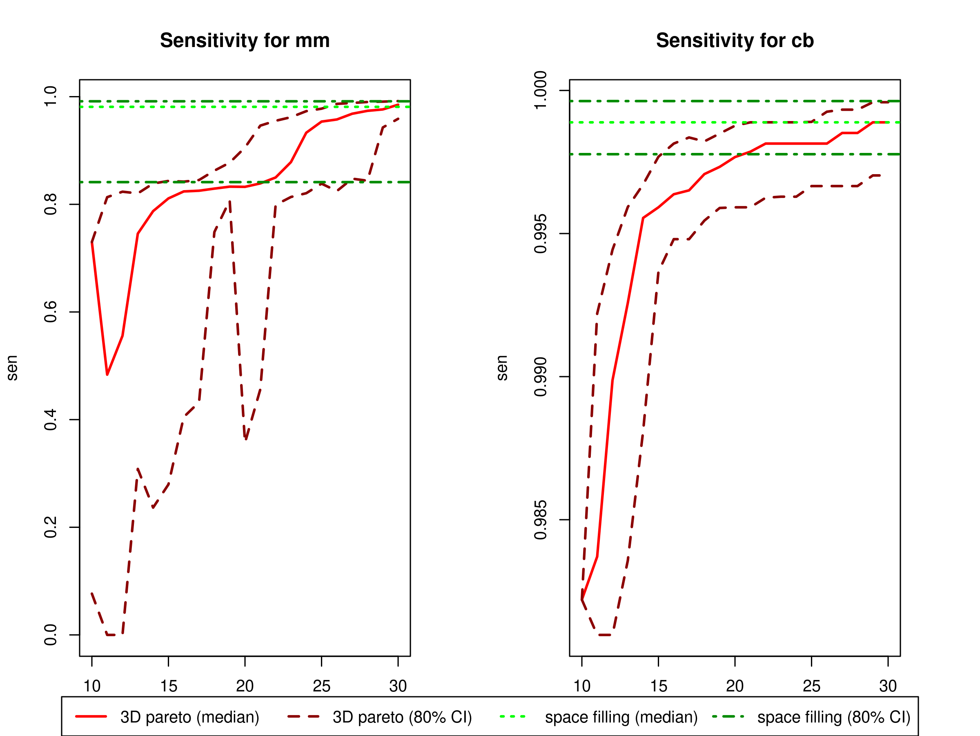
Simulation Results: RMSE and Sensitivity (100 replicates)

Slide 21
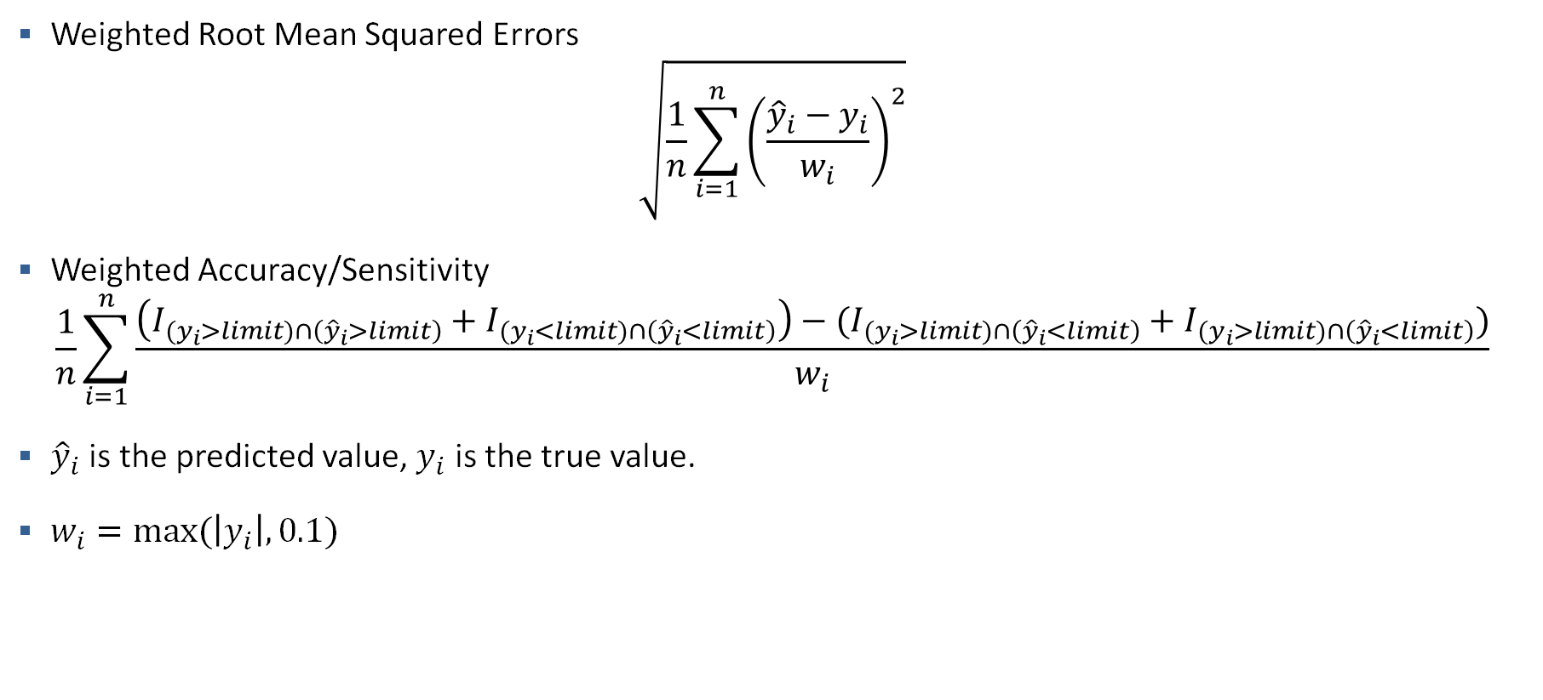
Improved Metrics for Multiple Contour Estimation
Weighted Root Mean Squared Errors
$$\sqrt{\frac{1}{n}\sum_{i=1}^{n}{{\left(\frac{{\hat{y}}_{i}−y_{i}}{w_{i}}\right)}^{2}}}$$
Weighted Accuracy/Sensitivity
$$\frac{1}{n}\sum_{i=1}^{n}{\frac{\left(I_{{(y}_{i}>limit)∩\left({\hat{y}}_{i}>limit\right)}+I_{{(y}_{i}<limit)∩\left({\hat{y}}_{i}<limit\right)}\right)−(I_{{(y}_{i}>limit)∩\left({\hat{y}}_{i}<limit\right)}+I_{{(y}_{i}>limit)∩\left({\hat{y}}_{i}<limit\right)})}{w_{i}}}$$
${\hat{y}}_{i}$ is the predicted value, $y_{i}$ is the true value.
$w_{i}=max⁡(\left|y_{i}\right|,0.1)$

Slide 22
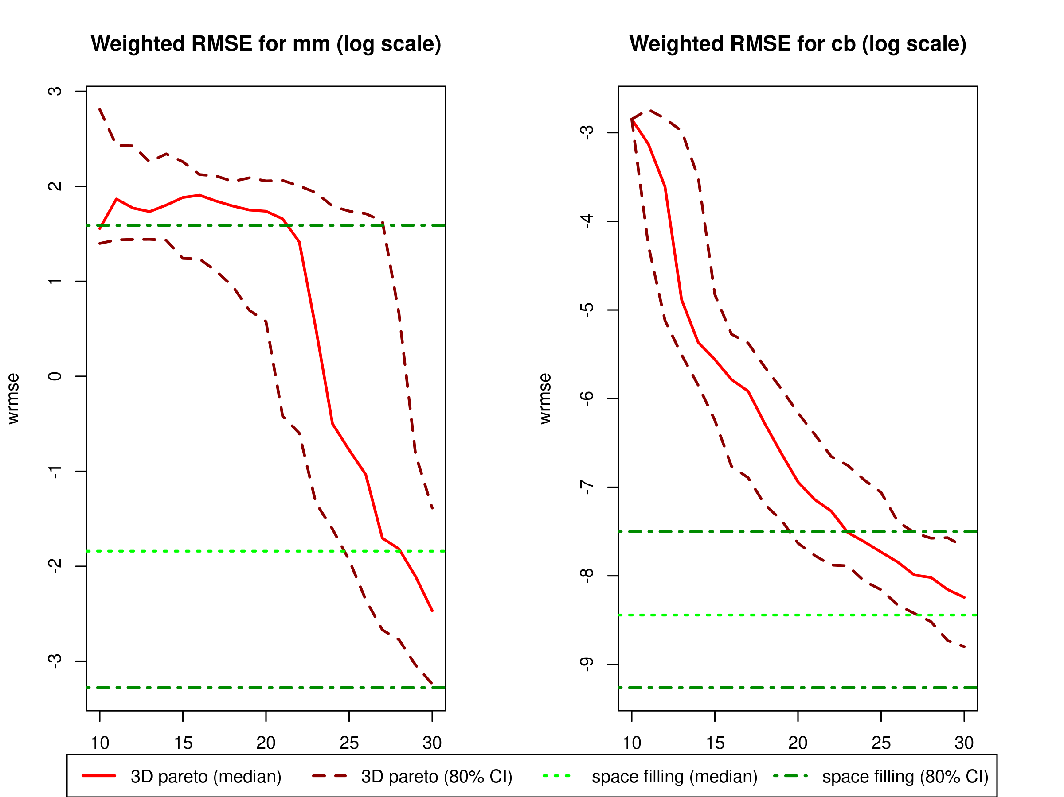
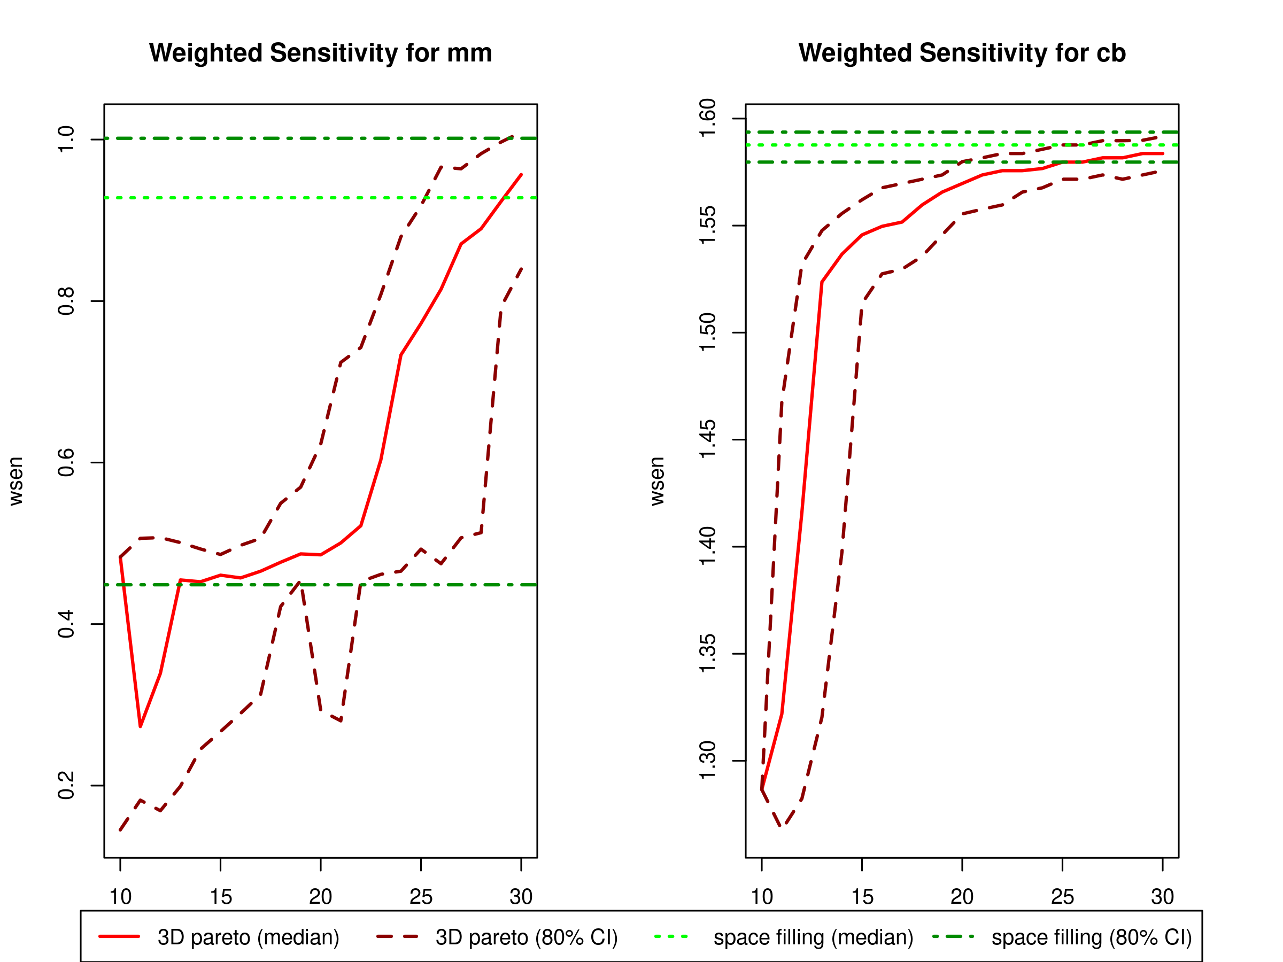
Simulation Results: Weighted RMSE and Sensitivity (100 replicates)

Slide 23
Conclusions
Deep GPs outperform regular GPs on analysis of HARV data
The proposed 3D Pareto approach balances exploitation and exploration for multiple contours simultaneously
  Randomly select a point among pareto front
  Keep the predictive standard deviation separate so not one variable dominates
  Sum the entropy since it is unitless
Different GP packages can affect performance.
Accurately evaluating model performance for contour estimation ensures that we have a good surrogate model

Slide 24
Future Work
Expand the toy example
Use deep Gaussian process for contour estimation
Apply the methods on our motivating example
Minimizing drag under the constraints of zero moments

Slide 25
References
Booth A. S., Renganathan S. A., and Gramacy R. B. (2024). “Contour Location for Reliability in Airfoil Simulation Experiments using Deep Gaussian Process.” arXiv: 2308.04420v2.
Annie Sauer, Robert B. Gramacy & David Higdon (2023). Active Learning for Deep Gaussian Process Surrogates, Technometrics, 65:1, 4-18.
Cole, D. A., Gramacy, R. B., Warner, J. E., Bomarito, G. F., Leser, P. E., & Leser, W. P. (2022). Entropy-based adaptive design for contour finding and estimating reliability. Journal of Quality Technology, 55(1), 43–60.
Picheny, V., Ginsbourger, D., Roustant, O., Haftka, R. T., and Kim, N. (June 29, 2010). "Adaptive Designs of Experiments for Accurate Approximation of a Target Region." ASME. J. Mech. Des. July 2010; 132(7): 071008.
Joakim Beck and Serge Guillas. Sequential Design with Mutual Information for Computer Experiments (MICE): Emulation of a Tsunami Model. SIAM/ASA Journal on Uncertainty Quantification 2016 4:1, 739-766.
Alexander Kraskov, Harald Stögbauer, and Peter Grassberger. Estimating mutual information. Phys. Rev. E 69, 066138 – Published 23 June 2004; Erratum Phys. Rev. E 83, 019903 (2011).
Schmidt K, Smith RC, Hite J et al. Sequential optimal positioning of mobile sensors using mutual information. Stat Anal Data Min: The ASA Data Sci Journal. 2019; 12: 465–478.
Gramacy, Robert B, Surrogates: Gaussian Process Modeling, Design and Optimization for the Applied Sciences.
Gramacy, R. B., Sauer, A. and Wycoff, N. (2022) Triangulation candidates for Bayesian optimization. arXiv: 2112.07457.

Slide 26
Contact Information
Email sprim@ncsu.edu

Slide 27
Disclaimer
This document was prepared as an account of work sponsored by an agency of the United States government. Neither the United States government nor Lawrence Livermore National Security, LLC, nor any of their employees makes any warranty, expressed or implied, or assumes any legal liability or responsibility for the accuracy, completeness, or usefulness of any information, apparatus, product, or process disclosed, or represents that its use would not infringe privately owned rights. Reference herein to any specific commercial product, process, or service by trade name, trademark, manufacturer, or otherwise does not necessarily constitute or imply its endorsement, recommendation, or favoring by the United States government or Lawrence Livermore National Security, LLC. The views and opinions of authors expressed herein do not necessarily state or reflect those of the United States government or Lawrence Livermore National Security, LLC, and shall not be used for advertising or product endorsement purposes.

